Slide 1

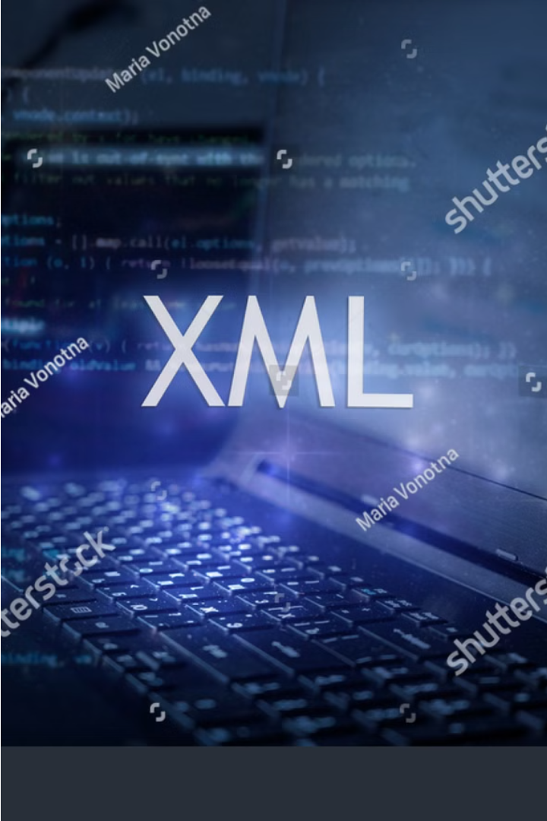


Introduction to XML
XML, or Extensible Markup Language, is a flexible and powerful standard for creating and structuring data. It provides a way to represent and exchange information in a format that is both human-readable and machine-readable.
by coderFRU

Slide 2
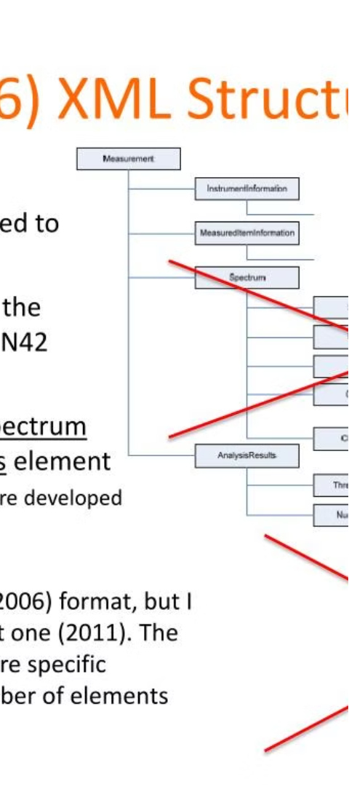
What is XML?
1
Markup Language
2
Data Description
XML is a markup language, which means it uses tags to define the structure and meaning of data.
XML allows you to describe data in a self-descriptive and hierarchical way, making it easy to understand and process.
3
Platform-Independent
XML is platform-independent, meaning it can be used on any operating system or programming language.

Slide 3
XML Structure and Syntax
Elements
Attributes
Hierarchy
XML documents are composed of elements, which are the building blocks of the data structure.
Elements can have attributes, which provide additional information about the element.
XML documents have a hierarchical structure, with elements nested within other elements.

Slide 4
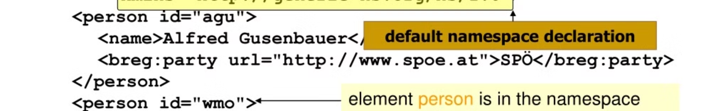
XML Namespaces
Purpose
Extensibility
XML namespaces provide a way to uniquely identify elements and attributes in an XML document.
Namespaces enable the extensibility of XML, allowing new vocabularies to be added without affecting existing ones.
1
2
3
Avoiding Conflicts
Namespaces help avoid naming conflicts when using multiple vocabularies in the same XML document.

Slide 5
XML Validation
DTDs
XML Schemas
Validation Process
DTDs (Document Type Definitions) define the structure and syntax of an XML document.
XML Schemas provide a more powerful and flexible way to define the structure and data types of an XML document.
XML documents can be validated against a DTD or XML Schema to ensure they conform to the expected structure and rules.

Slide 6



XML Parsing and Processing
Parsing
Transformation
Storage
XML parsers convert the XML document into a structured data representation, such as a DOM or SAX model.
XML can be transformed into other formats, such as HTML or PDF, using technologies like XSLT.
XML data can be stored and managed in XML databases or relational databases with XML support.

Slide 7




XML Applications and Use Cases
Web Services
Configuration Files
Document Formats
Data Exchange
XML is widely used for data exchange in web services, enabling interoperability between different systems.
XML is commonly used for configuration files, as it provides a structured and readable format.
XML is the foundation for many document formats, such as DOCX, XLSX, and SVG.
XML is an ideal format for exchanging data between different applications and platforms.

Slide 8

Conclusion and Key Takeaways
1
Flexibility and Extensibility
2
Widespread Adoption
XML has been widely adopted across various industries and domains, making it a crucial skill for professionals.
XML's flexibility and extensibility make it a powerful tool for representing and exchanging data.
3
Continuous Evolution
XML continues to evolve, with new technologies and standards emerging to enhance its capabilities.

